Slide 1
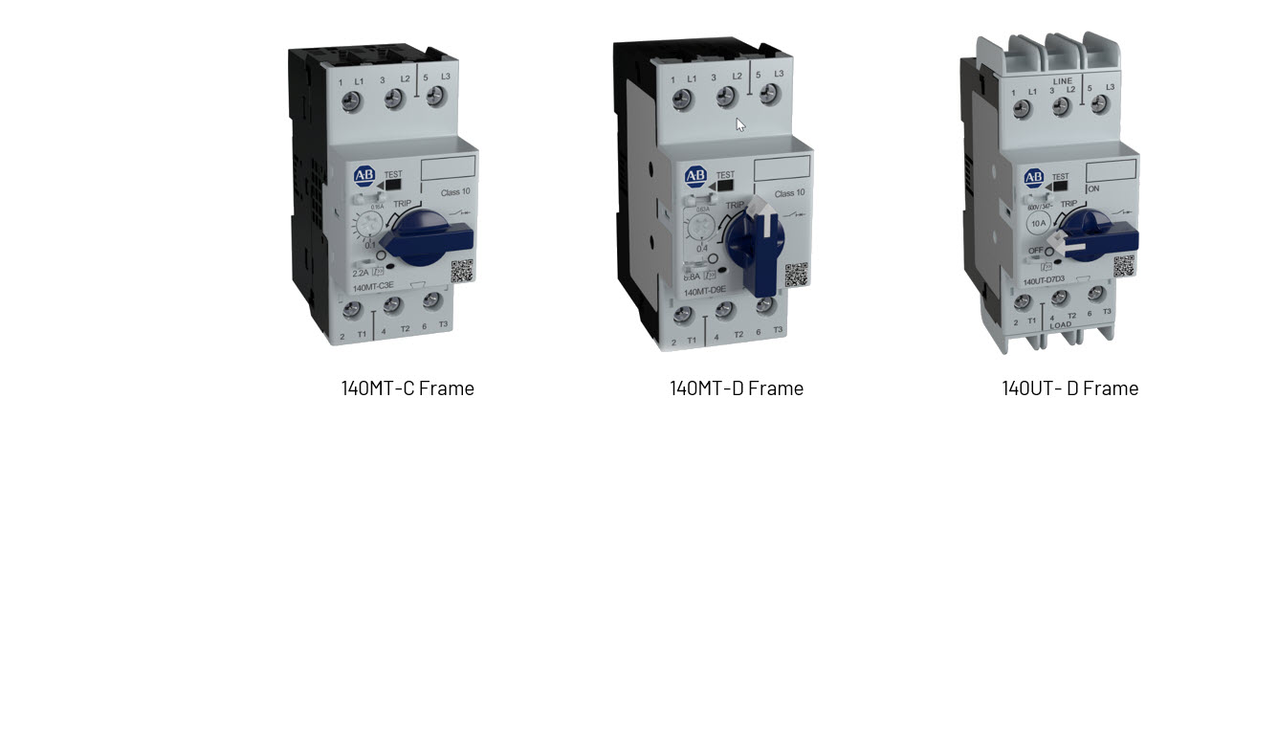
140MT, 140UT Overview
Ashwin Patel – June 2021

Slide 2
Glossary of Terms
MCCB, MPCB/MPSD, MCP - Functions
Molded Case Circuit Breaker - MCCB
  Feeder Distribution and Branch Circuit Protection (conductors, bus and cable)
    Short Circuit Protection
    Overcurrent Protection - calibrated for distribution conductor applications
    Disconnect Applications
Motor Protection Circuit Breaker – MPCB / Motor protection Switching Device - MPSD
  Motor Protection
    Disconnect for motor branch circuit
    Short Circuit Protection (Type E)
    Overload Protection - calibrated for motor overload applications
    Manual Controller (ON/OFF)
Motor Circuit Protector - MCP
  Motor Branch Circuit Protection
    Short Circuit Protection Only (magnetic trip only)
    Motor Overload protection that is provided with separate overload relay (e.g. 193-E)

Slide 3
Glossary of Terms
Application Ratings
Self-protected combination motor controller (construction type E)
Combination motor controller with coordinated protection, so as to permit continuity of service up to its rated short-circuit current. A self-protected combination motor controller is evaluated as a complete unit whether comprised of a single or multiple components. The coordinated protection may be inherent or obtained by correct selection of components or accessory parts in accordance with the manufacturer’s instructions. In North America, a Type E or self protected motor controller can be used in place of the branch circuit protection in a motor circuit.
Group Motor Installation (NEC Article 430.53)
A type of installation where a group of loads, consisting of two or more motors, or one or more motors and other loads, are able to be protected by a single set of branch circuit fuses or inverse – time circuit breaker. Refer to NEC 430.53 for detailed requirements of Group installation. Manual Motor Controllers are listed as suitable for group motor installation.
Tap Conductor Protection
A manual motor controller listed for tap conductor protection in group motor installations is permitted to have conductors that are no smaller than 1/10 the ampacity of branch circuit protective device. Refer to NEC 430.53 (D) for other restrictions

Slide 4
Glossary of Terms
MCCB, MPCB/MPSD, MCP
Motor Protection Circuit Breaker - MPCB
Manual motor controllers are also commercially referred to as Motor Protection circuit breaker or Motor protective circuit breaker. Some other manufacturer refers to these devices as Manual motor protector or Manual starter protector etc. But now IEC has defined term as MPSD.
Motor Protective Switching Device MPSD ( IEC 60947-4-1 reference 3.4.31))
Manually operated motor starter additionally providing resettable short-circuit protection to the motor and the circuit
-Note 1: A MPSD can also be used as a manual starter, a protected starter or a combination starter.
-Note 2: A MPSD can be used as a SCPD within the motor branch when rated as Type E
-Note 3: In North America, this device is also called manual motor controller.
Type 2 Short Circuit Coordination:
A listed motor controller with Type 2 Short Circuit Coordination meets the following criteria at the voltage and current it is rated at. The user must not exceed fuse or circuit breaker as recommended by the manufacturer.
  1. The contactor or starter must not endanger persons or plant in the event of a short circuit.
  2. No damage to the motor protection device or other parts may occur with the exception of welding of the contactor or starter contacts if these can be easily separated without appreciable deformation (such as with a screwdriver).

Slide 5
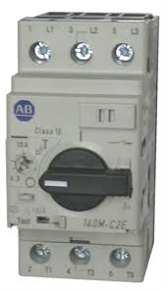
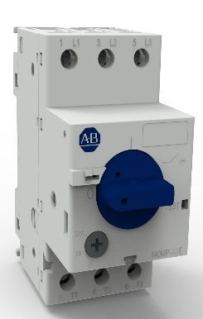
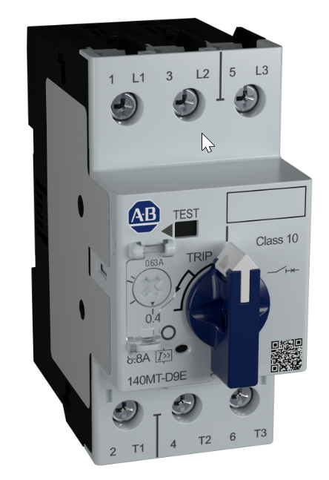
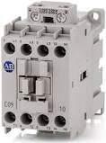
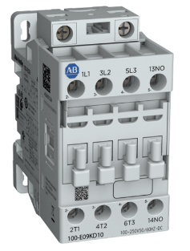
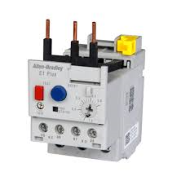
The evolution of the Motor Control & Protection portfolio
Complete renewal and expansion of our starter combinations
FY19
FY20
FY21
Tiered Portfolio
Basic Tier - 140MP
Global Performance – 140M/140MT
  Advanced - 140ME Electronic ( Future)
140MT – Why a new MPCB?
140M is 20+ year old product line.
No possibility of improving product features at reasonable cost with 140M anymore.
Renewal of the full Motor Control Portfolio → MCS2.0
Enhance performance and certifications
Future 140ME platform will be based on 140MT design (Subnet Enabler)
140M and New 140MP
NEW 140MP = Basic Tier Portfolio (price / simple applications)
140M = Global Performance
140MP and New 140MT
140MP = Basic Tier Portfolio
NEW 140MT = Global Performance (repl. 140M)
FY23 140ME = Electronic (future SubNet, flexibility)
100-C and New 100-E
100-C = Global Value Portfolio (productivity)
NEW 100-E = Global Performance (universal coil, future SubNet)
+
E200, E300 and New E100
NEW E100 EE = Basic (productivity, flexibility)
NEW E100 EF = Advanced (flexibility, future Subnet)
E200 = Stand-alone High Performance
E300 = Global Architecture (Data, Application)
5

Slide 6
140MT and 140UT Overview
Current Range extension & Improved thermal performance, Application Ratings
140MT-C frame is up to 32 A and 140MT-D frame is extending current range up to 40A
140UT are very compact UL 489 and IEC 60947-2 MCCB extending up to 40A
Higher short circuit ratings and application coverage (tap conductor protection and Type E ratings) for 140MT-D
Improved thermal performance compared to existing product line (Lower heat loss)
Different product variants (MCP, High inrush version, D9V for application at output of Drives) are covered by single frame size D.
Lockable knob and anti-tamper shield as standard offering for 140MT-D
Connecting modules and Combination SCCR tested with 100-E, 100-C and 100-K contactors.
Back feeding capability 140UT
Expanding global certifications (UL, CE, ATEX, IECEx, CCC, EAC, Morocco, KC, CB Scheme)

Slide 7
140MT Product line Overview
Extended Current Ratings – High Short Circuit performance
140MT Product line
  140MT MPCB Magnetic S/C & Thermal Overload Protection
  140MT MCP w Magnetic S/C protection
Product Attributes
  140MT – C up to 32A, D Frame up to 40A
  Short circuit protection 14 x Ie, 65kA @ 480V / 100kA @ 400V
  Overload Protection - Trip Class 10
  Common Electromechanical and Expansion Accessories
  Group motor installation, Tap conductor Protection, Type E Ratings
  Type F ratings, Type 1 and Type 2 SCCR testing
  Expanded certifications – CE, cULs, EAC, Marine, ATEX, CCC etc.
  New Auxiliaries and Accessories
Trip Test switch
Overload Trip Setting
Anti-Tamper Shield
Lockable knob
Trip Indicator (T)
QR Code
Short Circuit Trip
Indicator Flag (I>>)
Protection and Control Functions - MPCB
  Disconnect for Motor Branch Circuit
  Branch Circuit, Short Circuit Protection
  Overload Protection (Thermal Protection)
  Switching (Manual)

Slide 8
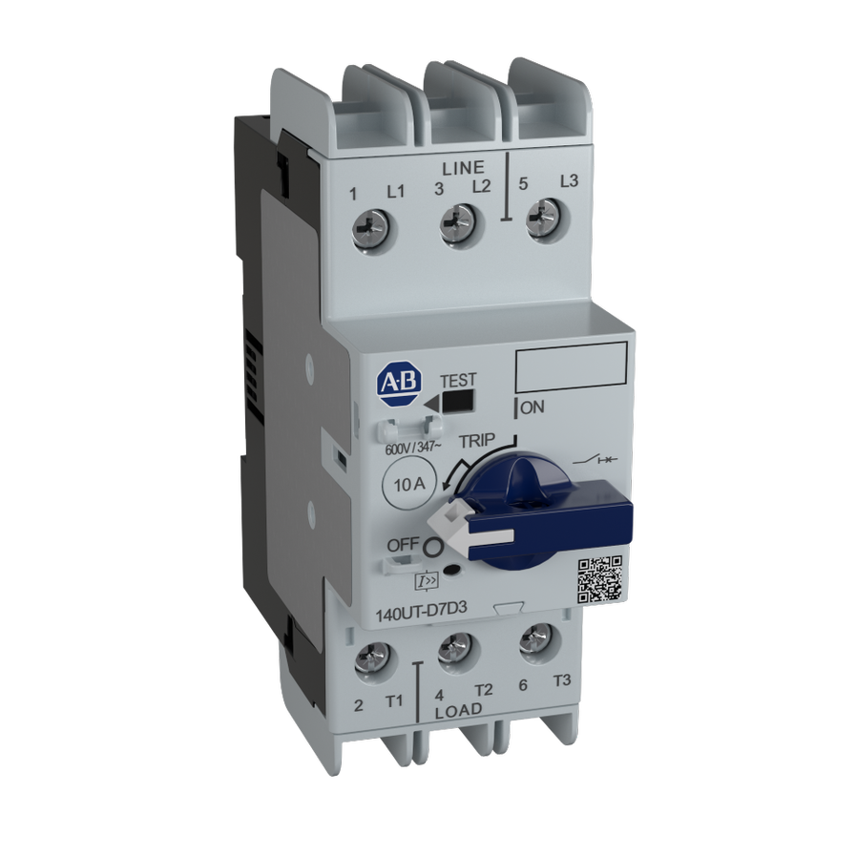
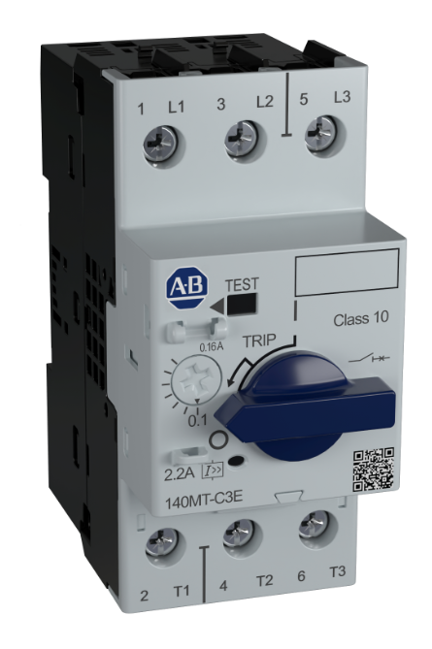
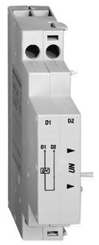
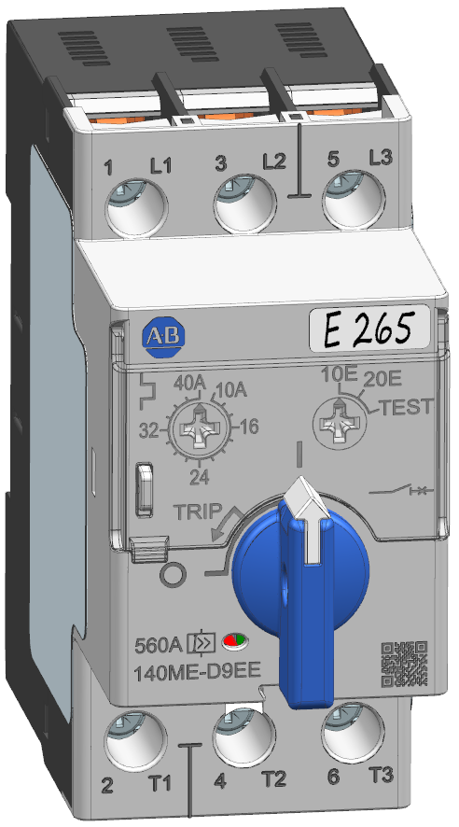

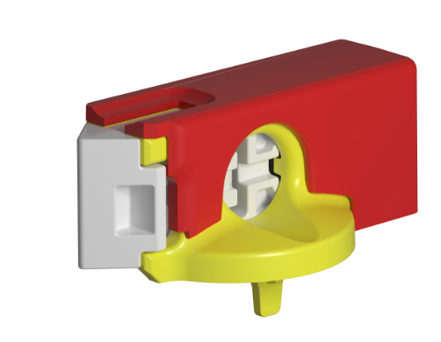

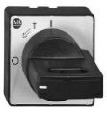

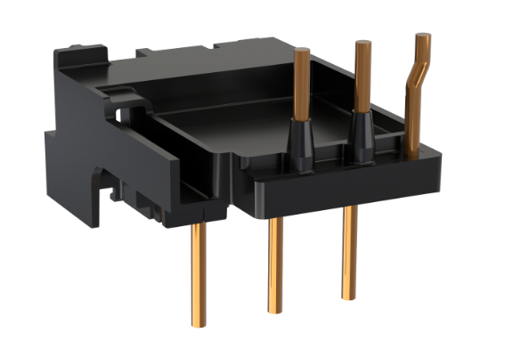
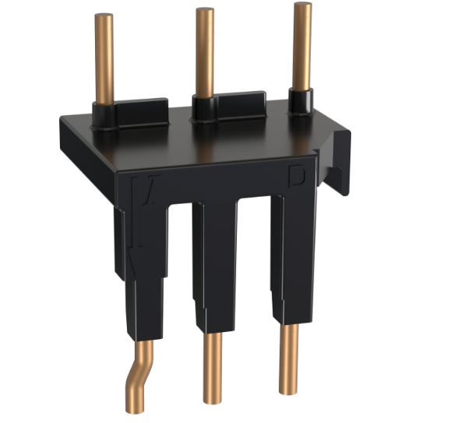
140MT Product line Variants
All Variants part of D Frame
45 mm
45 mm
45 mm
140MT-C Frame 0.1 – 32 A
140MT-D Frame 0.1 – 40 A
140UT- D Frame 0.5 – 40 A
140MT /UT- Accessories (NEW)
  MPCB - S/C & Overload Protection
    Standard MPCB (14 x Ie) (MPCB)
    High Inrush version (19…22 x Ie) MPCB
    MPCB for application at output of VFD
    Motor Circuit Protector (MCP) – No thermal trip
    Standard lockable knob
    Standard Anti-Tamper shield
    MCCB version replacing 140U-D

Slide 9
140MT MPCB / MPSD
Motor Protection Circuit Breaker / Motor Protective Switching Devices
Protection and Control Functions - MPCB
  Disconnect for Motor Branch Circuit
  Branch-Circuit, Short Circuit Protection (Magnetic Protection)
  Overload Protection (Thermal Protection)
  Switching (Manual)
  Features
  Fixed Magnetic Trip – C3E, D9E, F8E (13…14 x Ie)
  High Inrush MPCB – D9T & F8T (16…21 X Ie)
  Motor overload protection, Trip Class 10
  High Current limiting, Visible Trip Indication
  Version for application at output of VFD (D9V)
  Group motor installation, Tap conductor Protection and Type E ratings

Slide 10
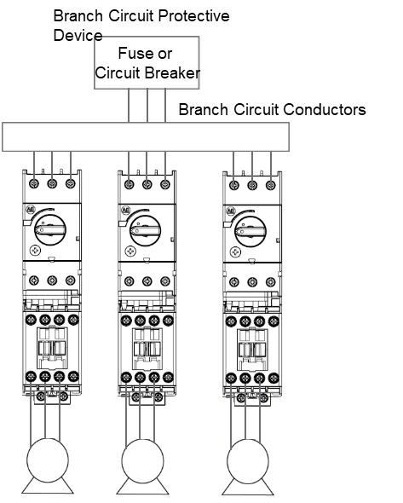


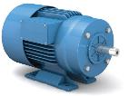
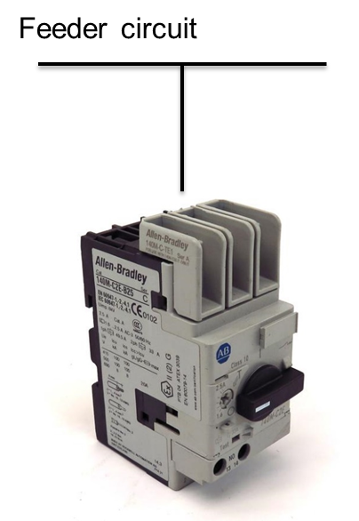
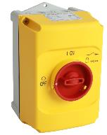
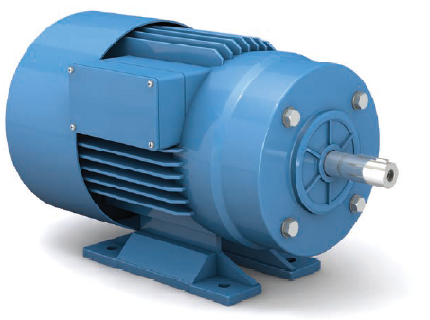
140MT, 140MP Applications
MPCB/MPSD Applications – North America
MPCB/MPSD
Contactor
Load
  140MT & 140MP both are listed for Group motor application
  SCCR combination tested with 100-E, 100-C & 100-K contactors
  140MT are listed for Tap conductor protection enables in tap conductor size reduction (140MP are not listed for this)
Protect & Control
140MT, 140MP
100-C,E,K
MPCB
Contactor
Load
  Type F Combination controller 140MT+100-C,E
  140MT are listed as Type E (Self protected combination motor controller
  Can be applied without BCPD (branch circuit protection)
Protect & Control
140MT
100-C,E
At motor disconnect
/ Manual motor starter
  140MT and 140MP both are rated as motor disconnect
  140MP is economical and competitive
  140MP have enclosures as accessories
140MT, 140MP
Definition on Group motor and Type E refer to below link -
140M Application UL NEC IEC V2

Slide 11
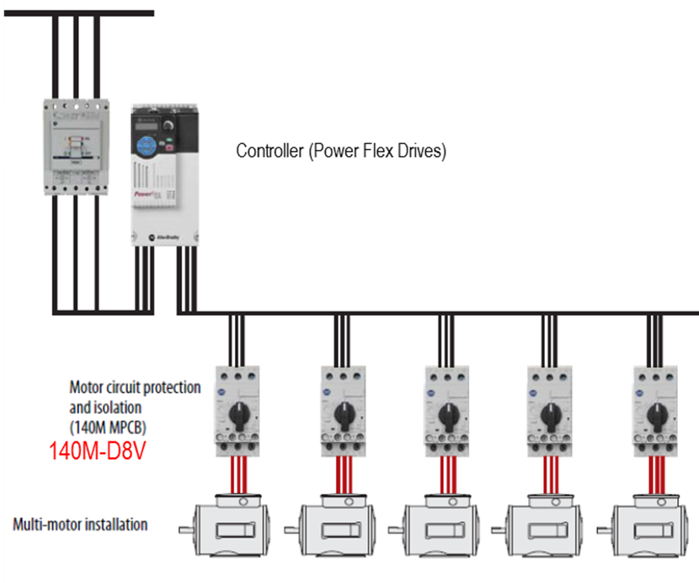
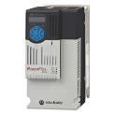
140MT, 140MP Applications
With Drives - North America
  Application at output of Drives for multi motor application
  Need special design due to voltage wave reflections
  140MT-D9V are design and tested for these applications
AFC- To be communicated
MPCB/MCCB
VFDs (PF 520)
Load
  Type E rated device can be applied for input protection of Drives
  To be tested in combination with Drives & Listed in Drives manuals
  140MT are Type E rated and will be tested with PowerFlex® 520 Drives
Protect & Control
140MT/140UT

Slide 12
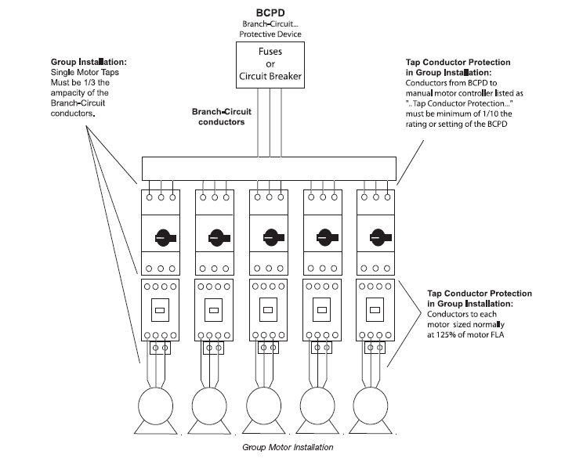
140MT Group motor & Tap conductor ratings
UL SCCR for Group motor
140MT UL Listed for Group motor installation
A Group motor installations removes the requirement to provide a circuit breaker of fuse for each motor circuit which helps to reduce cost and save space.
Tap conductor protection ratings allows reduction in conductor sizing
The contactor provides for remote control
Lockable handles (accessory) provide a disconnecting means for individual motor circuits.
Adding compact busbar and feeder terminal accessories …
  Provides efficient power distribution to each motor circuit.
  Eliminates time and cost of additional wiring
This type of installation allows for non motor loads to be connected to same BCPD as well.
140MT UL Listed for Group motor installation with 100-C, 100-E and 100-K contactors also

Slide 13
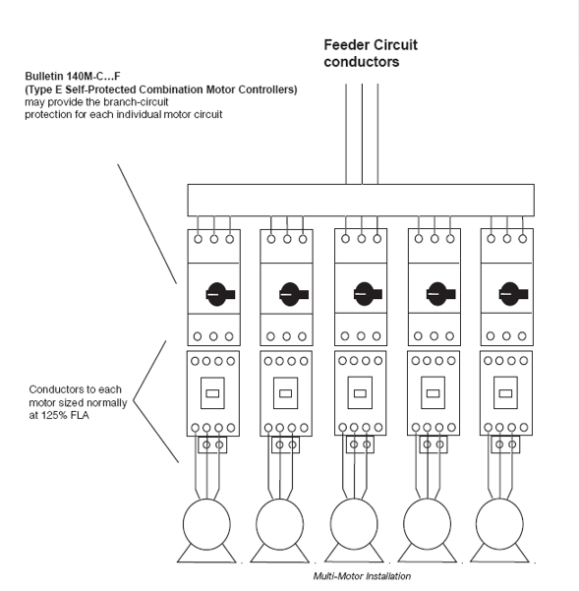
140MT Type E ratings
Self-protected Combination motor controller Type E & Type F ratings with contactors
140MT UL Listed Manual, Self-Protected Combination Motor Controllers
140MT (Type E Listed) provides all the necessary NEC/CEC requirements for the protection and control of individual Motor Branch Circuits without additional protective devices.
Can be directly connected to feeder circuit
Type F combination motor controller consists of a Type E manual self protected combination motor controller and a magnetic or solid-state motor controller (such as a Bulletin 100-C, 100-E contactor or an SMC™).
140MT UL Listed as Type F combination motor controller with 100-C, 100-E and 100-K contactors

Slide 14
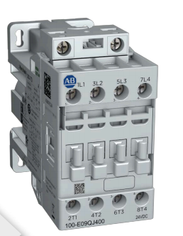
140MT Type 2 ratings
Type 2 Short Circuit Coordination with 100-C, 100-E
Type 2 Short Circuit Coordination:
The contactor or starter must not endanger persons or plant in the event of a short circuit.
No damage to the motor protection device or other parts may occur with the exception of welding of the contactor or starter contacts if these can be easily separated without appreciable deformation (such as with a screwdriver).
In the event of short circuit, fast-opening, current-limiting Bulletin 140M Motor Protection Circuit Breakers make it possible to build economical, fully short-circuit coordinated starter combinations with Type 2 coordination.

Slide 15
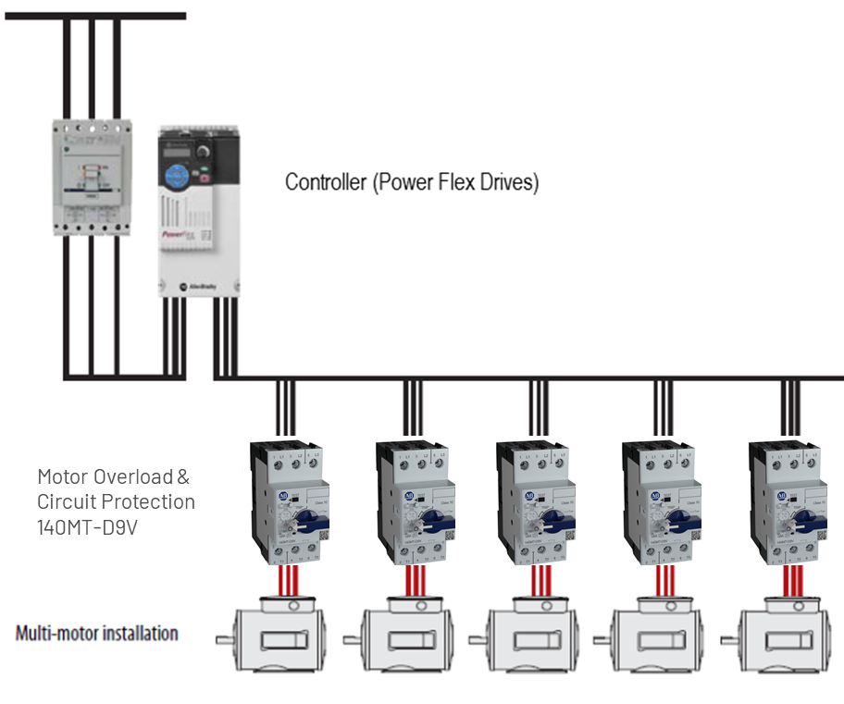
140MT-D9V
At output of VFD
Application
In multiple motor applications, NEC §430, part III, requires individual motor overload protection, that is (thermal) overload function, on the load side of a VFD only
Rated to provide short circuit protection for individual motor circuit Tap conductors where required.
140MT-D9V are suitable for application at output of VFDs in multi-motor installation
  PWM frequency ≤ 4 kHz
  VFD output frequency ≤ 400 Hz
  Current setting = rated motor current
  Maximum cable length of drive instruction manual apply
  Preferred location of MPCB installations is as close to the motor as possible

Slide 16
140MT-D9V
At output of VFD
Recommendations for VFD:
VFD Sizing: Add FLA and add at least 20% due to lower leakage inductance.
On PowerFlex® 520 don't go below 3 hp due to capacitive coupling (cable charging current).
Adding a common mode core and using XLPE cable will minimize cable charging current
Drives must be set in VHz motor control
If motor cables are long a PowerFlex® 750 and 1204-RWR would be recommended due to the lower dv/dt of drive
Do not “line start/stop” motor when VFD is running
A common mode core 1321-Mxxx & 1204 RWRx are recommended for long lead motor cables
*Please contact Drive Technical Support for additional information if needed 1.440.646.3434

Slide 17
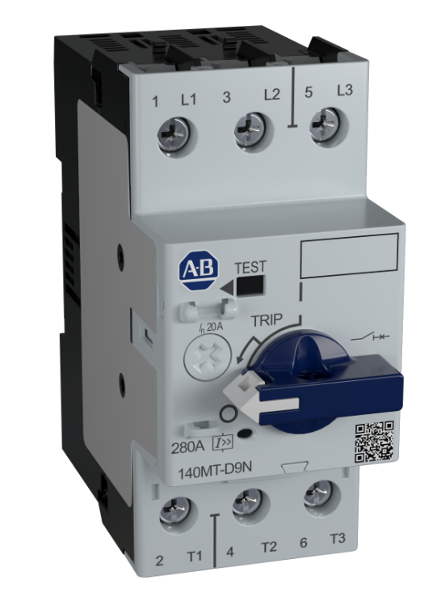

140MT MCP & Application
MCP – Motor Circuit Protector
140MT Motor Circuit Protectors (MCP)
  140MT D Frame 0.16 – 40 A
  140M F Frame 25 - 45 A
140MT MCP Product Overview
  Motor Circuit Protector – MCP ( D9N, F8N)
  Fixed Magnetic Trip – (13….14 x Ie)
  Provides short circuit protection for 3-components starter
  No motor overload protection
  For Trip Class 10 application
  Need derating for heavy duty starting (Trip class 15,20,30)
MCP
Contactor
Overload
Load
  For 3 component starter MCP variants with magnetic trip only is required to provide short circuit protection
  140MT-D9N are only MCP version (not available in 140MP)
  Tested as 3 component combination starters
Protect & Control
140MT-D9N
100-C,E
E100

Slide 18
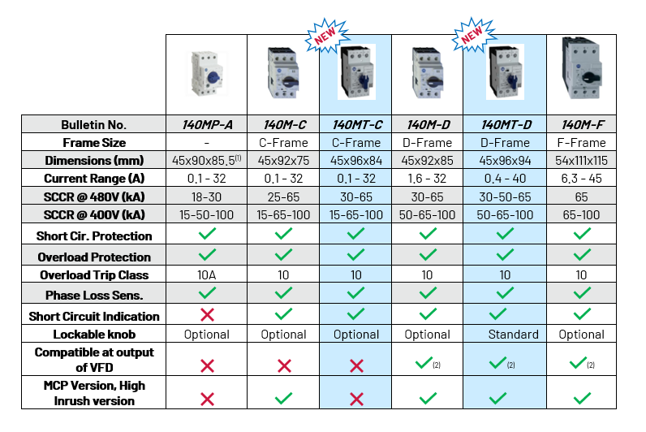
140M, 140MP, 140MT
Comparison overview

Slide 19
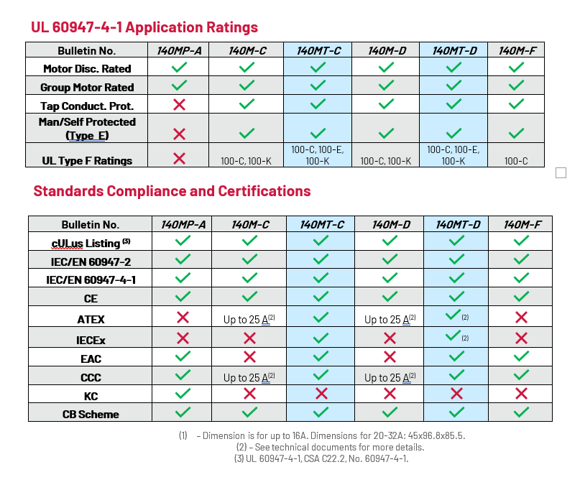
140M, 140MP, 140MT
Comparison overview

Slide 20
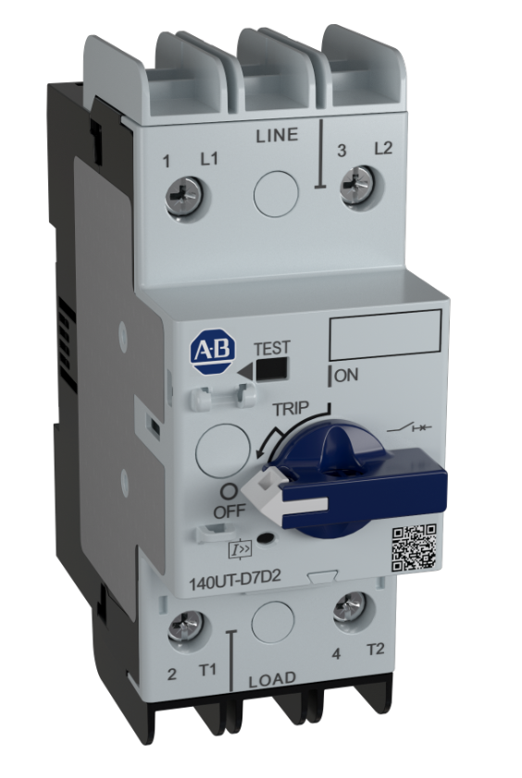
140UT Product line Overview
Current Limiting Circuit Breakers
140UT Product line
  140UT MCCB – Short circuit protection, Thermal overcurrent protection
  2 Pole & 3 Pole versions
  Replaces 140U-D
Product Attributes
  140UT – D Frame 40 A
  Short circuit protection up to 100kA @ 480Y/277V, 100kA @ 400V
  Common Electromechanical and Expansion Accessories with 140MT
  Current limiting
  Suitable for back feeding
  100% rated up to 12A
  UL 489 & IEC 60947-2
Trip Test switch
Lockable knob
Trip Indicator (T)
Short Circuit Trip
Indicator Flag (I>>)
QR Code
2 Pole

Slide 21
140UT Accessories
All Aux and Handles common with 140MT
140UT Compact busbar 64A
140UT Connection Modules
  Eco connection module 25A
Common Accessories from 140MT line
  Front mount auxiliary contacts
  Lockable knobs
  Door handles
  Shunt and under voltage trip units

Slide 22
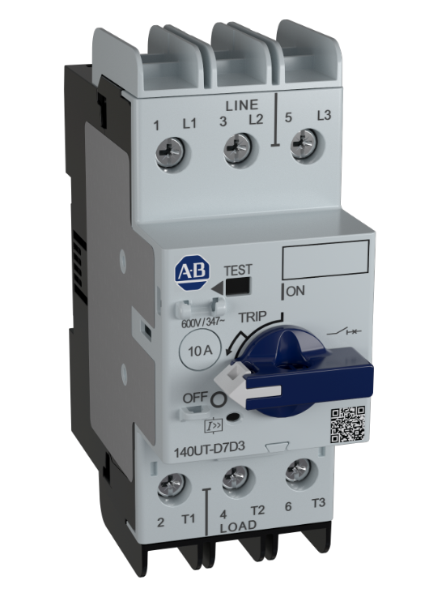
14UT-D Applications
MCCB Application
MCCB
Non- motor load
  Requires UL 489 certified MCCB for non-motor loads
  140UT-D are UL 489 listed
  Heating, air conditioning and refrigeration (HACR), HID & SWD ratings
Heaters
Transformers
Control Circuit
Lighting
Protect & Control
140UT-D
MCCB
  Requires UL 489 certified MCCB as BCPD
  Small Panels
Protect & Control
140UT-D
140UT Advantage:
Space saving – Very compact MCCB
Current limiting
High interrupting rating
2 & 3 pole devices
Compact busbar accessories & connection modules for contactors
Suitable for back feeding

Slide 23
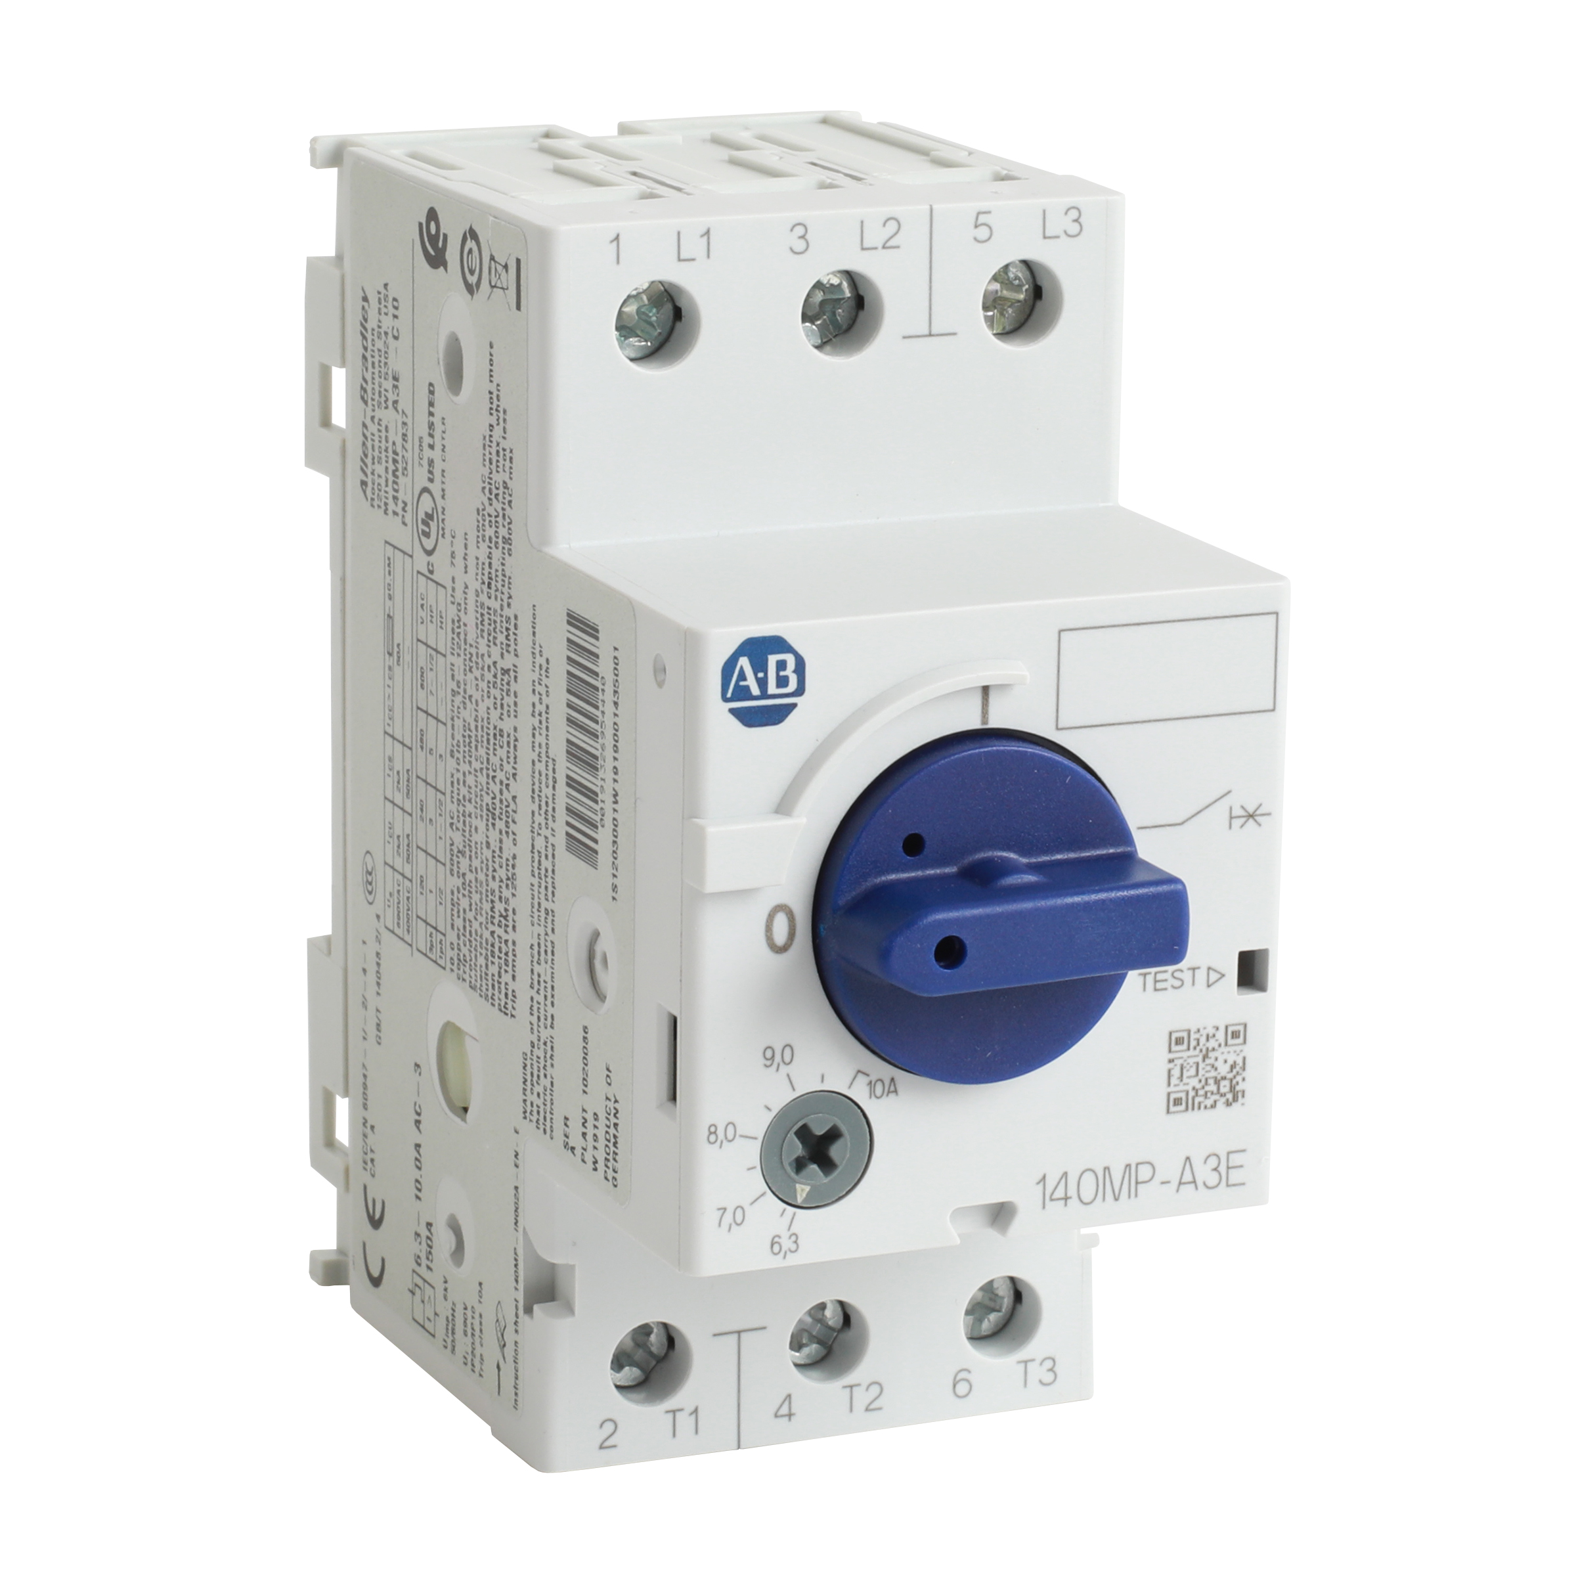
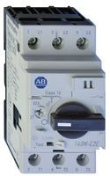
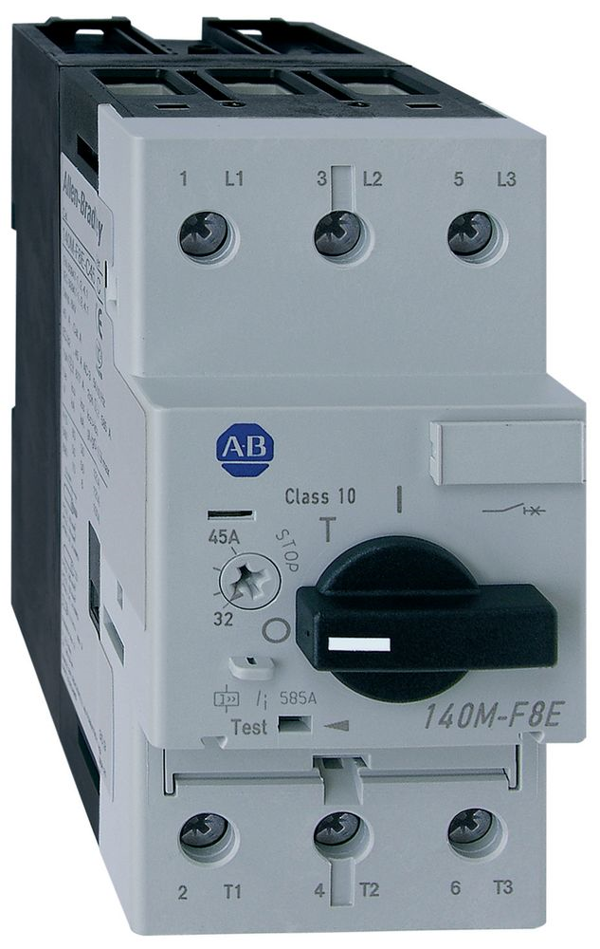
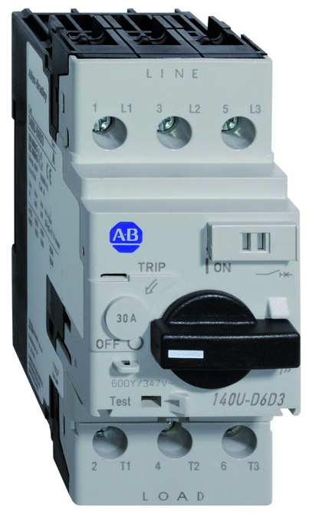
140M to 140MT Migration
140MT C/D Frame AFC –August 2021
140UT MCCB AFC - August 2021
140M-F Lifecycle status remains Active
Remains Active
140MP
140M- C &D Frame
140MT – C&D Frame
140U- D MCCB
140UT- D MCCB
140M -F Frame
6.3 - 45 A

Slide 24
Current Range
140M current range
140MT current range
Frame C –
Normal break (C2E) 0.10 – 32A
Normal break, high Inrush (C2T) 0.10 – 16A
MCP Normal break (C2N) 0.10 – 2.5A
Frame D –
High break (D8E) 1.6 – 32A
High break, high Inrush (D8T) 16 – 20A
High break for VFD output (D8V) 1.0 – 32A
MCP High break (D8N) 1.6 – 32A
Frame F –
Unchanged 6.3 – 45A
Frame C –
Normal break (C3E) 0.10 – 32A
Frame D –
High break (D9E) 0.40 – 40A
High break, high Inrush (D9T) 0.1 – 25A
High break for VFD output (D9V) 1.0 – 40A
MCP High break (D9N) 0.1 – 40A
(Frame F –)
No Change (use 140M-F) 6.3 – 45A

Slide 25
Accessories – Auxiliary contacts
140M aux. contacts
140MT aux. contacts
140M Trip contacts
140MT Trip contacts
140M-C-AFA10
140M-C-AFA01
140M-C-AFA11
140M-C-AFA20
140M-C-AFA02
140M-C-ASA20
140M-C-ASA02
140M-C-ASA11
140MT-C-AFA10
140MT-C-AFA11
140MT-C-AFA20
140MT-C-ASA20
140MT-C-ASA02
140MT-C-ASA11
140M-C-AFAR10A10
140M-C-AFAR10A01
140M-C-ASAR10M10
140M-C-ASAR10M01
140M-C-ASAR01M10
140M-C-ASAR01M01
140M-C-ASAM11
140MT-C-AFAR10A10
140MT-C-AFAR10A01
140MT-C-AFAR01A10
140MT-C-AFAR10M10
Red = to be discontinued
Green = new type

Slide 26
Accessories – Undervoltage- and Shunt Trips
Undervoltage Trip units
Shunt Trip units
140M - 140M-C-UX / UC(*)
140MT - 140MT-C-UX
140M - 140M-C-SN
140MT - 140MT-C-SN
(*)Undervoltage trip units with early make contacts will not be offered with 140MT
24V, 60 Hz
24V, 50 Hz
120V, 60 Hz
110V, 50 Hz
208V, 60 Hz
220…230V, 50 Hz
240…260V, 60 Hz
277V, 60 Hz
380…400V, 50 Hz
480V, 60 Hz/415V, 50 Hz
575V, 60 Hz/500V, 50 Hz
24V, 60 Hz
24V, 50 Hz
110V, 50 Hz/120V, 60 Hz
208V, 60 Hz
220…230V, 50 Hz
240…260V, 60 Hz
277V, 60 Hz
380…400V, 50 Hz
480V, 60 Hz/415V, 50 Hz
575V, 60 Hz/500V, 50 Hz
600V, 60 Hz
24V DC
24V, 50 Hz
120V, 60 Hz
220…230V, 50 Hz
240…260V, 60 Hz
380…400V, 50 Hz
480V, 60 Hz/415V, 50 Hz
24V, 50 Hz
110V, 50 Hz/120V, 60 Hz
220…230V, 50 Hz
240…260V, 60 Hz
277V, 60 Hz
380…400V, 50 Hz
480V, 60 Hz/415V, 50 Hz
24V DC
Red = to be discontinued

Slide 27
Accessories – Others
 | 140M | 140MT
Anti-Tamper Shield | X | X
Lockable Twist Knob | X (1 Padlock 5mm) Black, R/Y | X (1 Padlock 4-6mm) Blue, Black, R/Y
Locking Tag | X | X
Door Coupling Handle | X (Black, R/Y) | X (Black, R/Y)
Extension Shaft & Support | X | X
Legend Plate | X | X
Screw Adapter | X | X
IP65 Non-Metallic Enclosure | X | Late 2021 (TBD)
Compact Busbar System (2-5 connections 45mm & 54mm) | X | X
ECO Connecting Modules | 100-K, -C | 100-K, -C and -E
Standard Connecting Modules | 100-C | 100-C

Slide 28
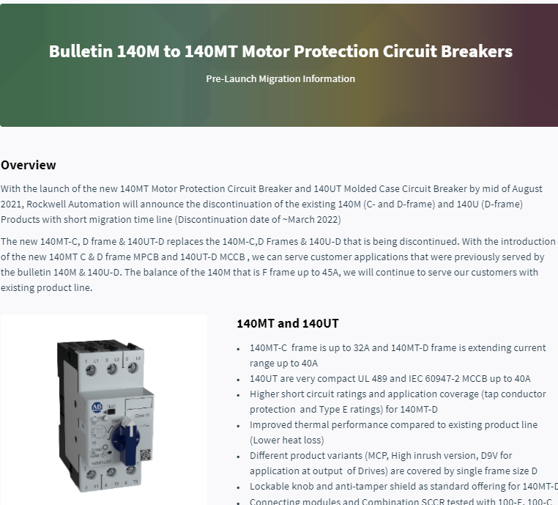
Documentation & Actions
Early Announcement
Documentation
Others
Migration guide – Now in Literature Library and Seismic
Tech Specification Draft – Now on Seismic
Drawings, 3D stp files (Main devices) –Now on Seismic
Product Presentation - Now on Seismic
140M Lifecycle Status letter - Now on Seismic
FAQ - Now on Seismic
Combination SCCR Specification Draft – in Tech Spec
SCCR tool updates- Aug
ProposalWorks™ – Aug
Early announcement of discontinuation to selected customers – June
Seismic Link for documentation – Now
Incentivize early transition through discount - Aug
Conversion report – Power BI report for TBL – Ready now
GRM Communication to Distributors - Done
Seismic link: 140M to 140MT Pre-Launch Migration Information

Slide 29
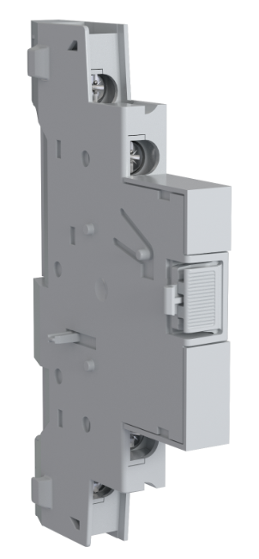
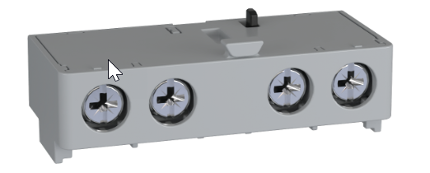
140MT Factory Configuration – Aux & Handles
140MT + Accessories
Factory Configured 140MT with Aux, Knobs etc. – Dec 2021 (working on early launch)
  E.g 140MT-C3E-B63-CX-KRY

Slide 30
140MP 140MT Comparison

Slide 31
Documentation & Actions
Initiating release to– Literature Library
Documentation – Now on Seismic
Others
Migration guide
Tech Specification Draft – 140MT
Tech Specification Draft – 140UT
Drawings, 3D stp files (Main devices)
Installation Instructions
Product Presentation
Migration letter
FAQ Document
140M 140MT Comparison Overview
Combination SCCR Specification Draft – in Tech Spec
Website update – 16 August
SCCR tool updates (Type F) – 30 Aug
ProposalWorks™ – 30 Aug
IDEA Update – 16 Aug
Seismic link: 140M to 140MT Pre-Launch Migration Information

